Slide 1
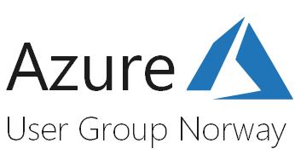

Analysere Azure AD Activity Logs med Azure Log Analytics and Azure Monitor
28. November 2018
Jan Vidar Elven, Skill AS
Notes:
Med Azure Log Analytics og Azure Monitor kan du få innsikt og viktige varsler for ditt Azure miljø, og med den nylige annonserte muligheten for å eksportere Azure AD Activity Logs til Log Analytics kan du få samme innsikt i alle sign-ins og audit events. Vi tar en titt på hvordan dette fungerer og ser på noen relevante demoer!

Slide 2

Jan Vidar Elven
Enterprise Mobility MVP
Cloud Architect @ Skill AS
@skillriver | gotoguy.blog

Slide 3
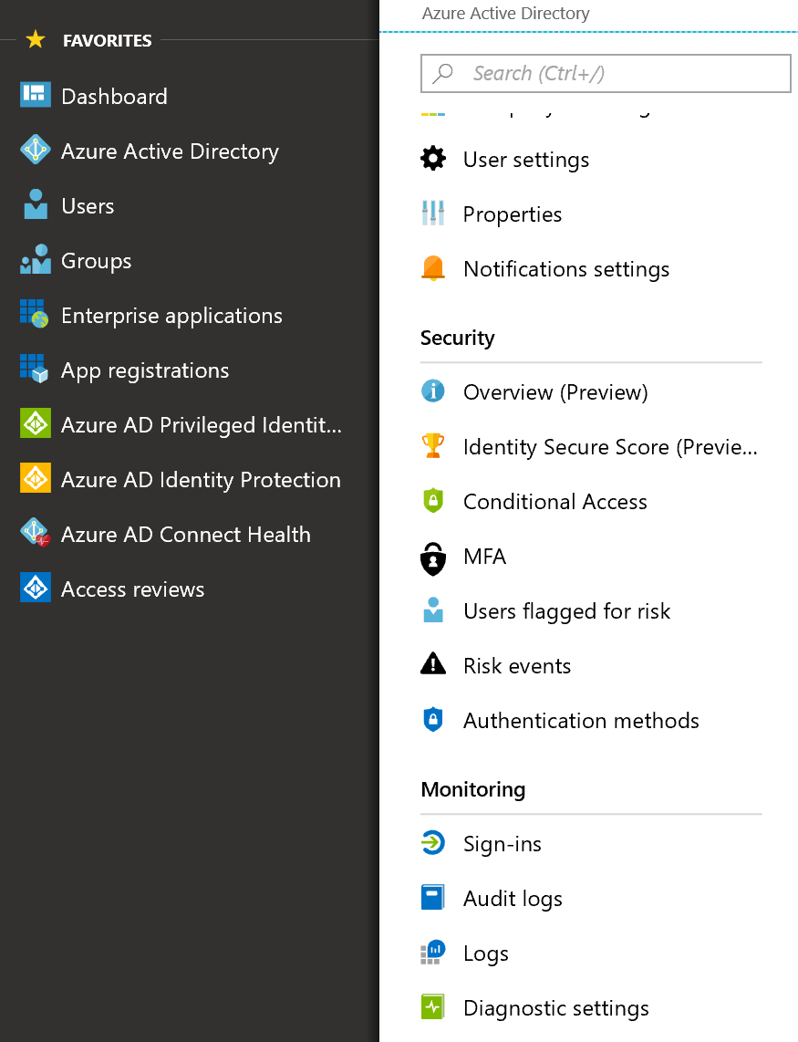
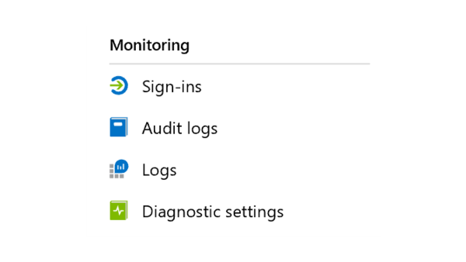
Om Azure AD Activity Logs
Sign-ins
All sign-in relatert info, inkludert Conditional Access
Krever Azure AD Premium i tenant
30 dager retention
Audit Log
Endringer i Directory
7 dager retention i AAD Free, 30 dager i Premium
Reporting API
Power BI Azure AD Activity Logs
Notes:
Audit events, f.eks.:
What types of updates have been applied the users?
How many users were changed?
How many passwords were changed?
What has an administrator done in a directory?
What are the groups that have been added?
Are there groups with membership changes?
Have the owners of group been changed?
What licenses have been assigned to a group or a user?

Slide 4
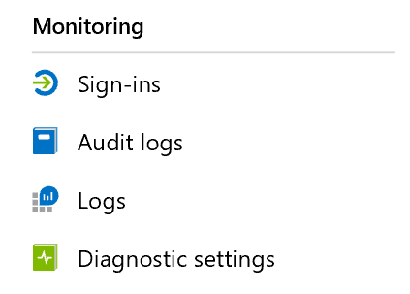

Slide 5
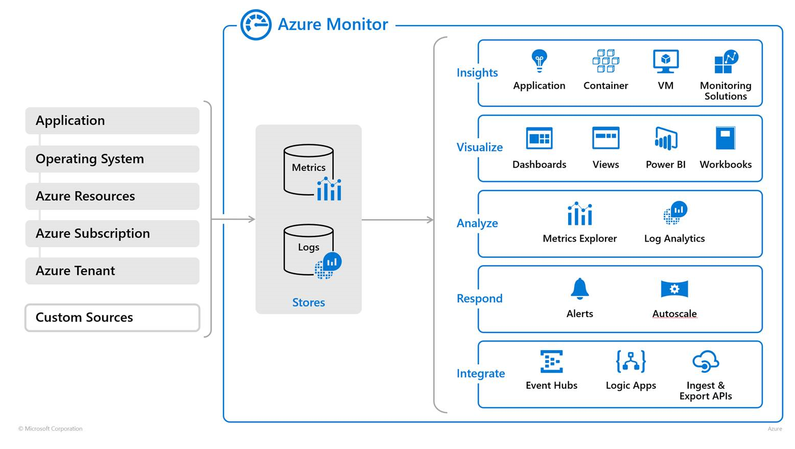
Om Azure Monitor
Notes:
All data som er samlet inn av Azure Monitor lagres i data stores for Metrics og Logs, hvor kilden kan være
Consolidation of monitoring services into Azure Monitor
Log Analytics and Application Insights have been consolidated into Azure Monitor to provide a single integrated experience for monitoring Azure resources and hybrid environments. No functionality has been removed from these services, and users can perform the same scenarios that they've always completed with no loss or compromise of any features.
Documentation for each of these services has been consolidated into a single set of content for Azure Monitor. This will assist the reader in finding all of the content for a particular monitoring scenario in a single location as opposed to having to reference multiple sets of content. As the consolidated service evolves, the content will become more integrated.

Slide 6
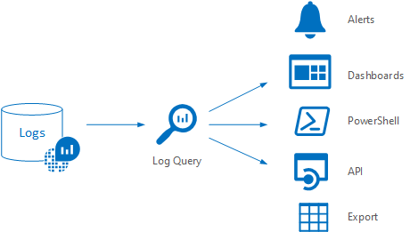
Om Log Analytics
Notes:
Log Analytics redefinition
Log Analytics has played a central role in Azure management by collecting telemetry and other data from a variety of sources and providing a query language and analytics engine that gives you insights into the operation of your applications and resources. It will continue to fill this critical role as a feature of Azure Monitor. Other features that were considered part of Log Analytics such as agents and solutions will be repositioned as features of Azure Monitor. Their functionality hasn't changed other than potential improvements to their experience in the Azure portal.

Slide 7
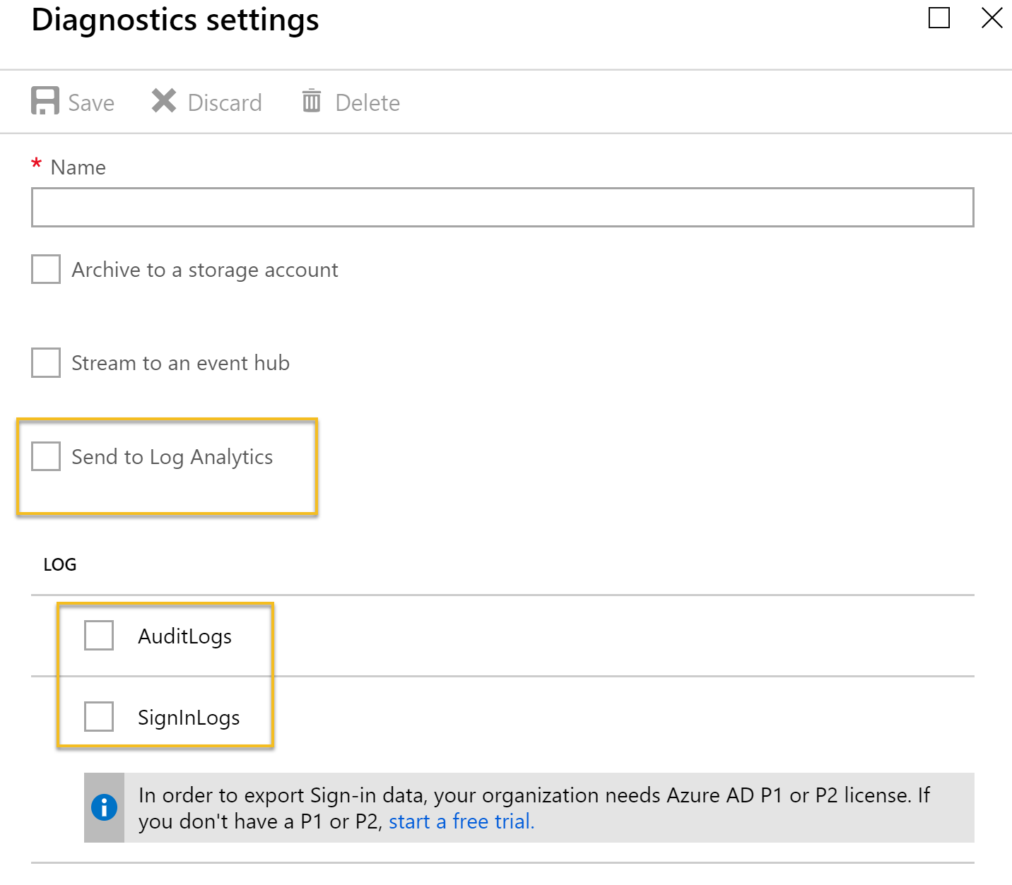
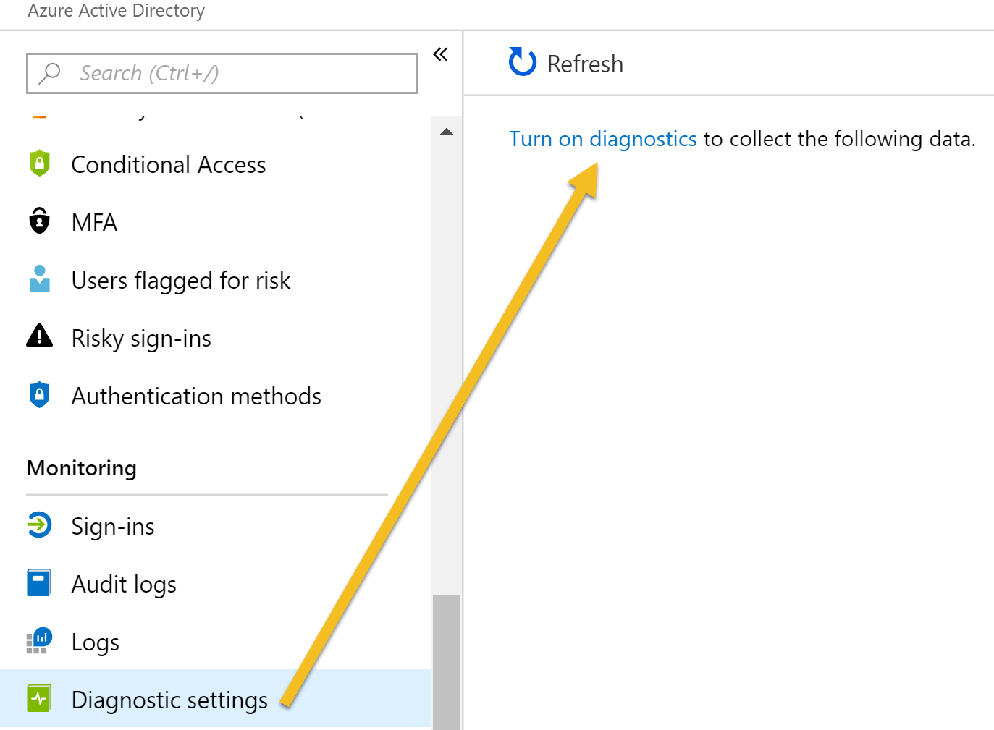
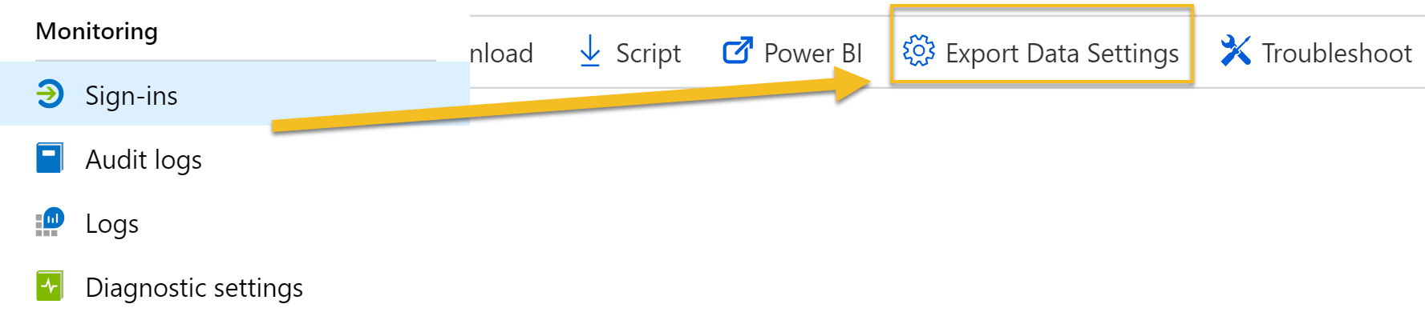
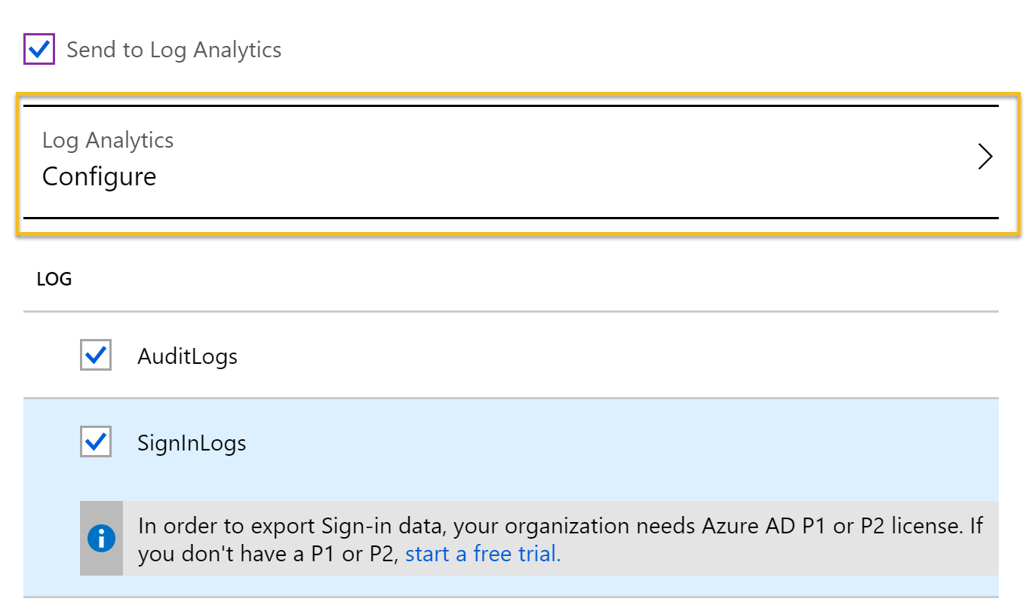
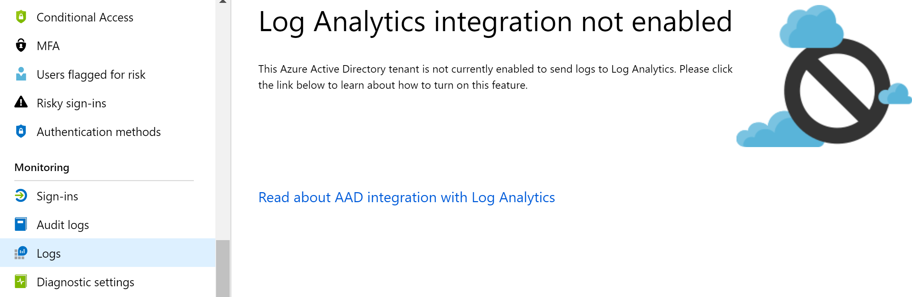
Aktivere AAD integrasjon
Notes:
Krever at du er Global Administrator eller Security Administrator
Krever Azure Subscription
Sign-in logs krever Azure AD Premium P1 eller P2

Slide 8
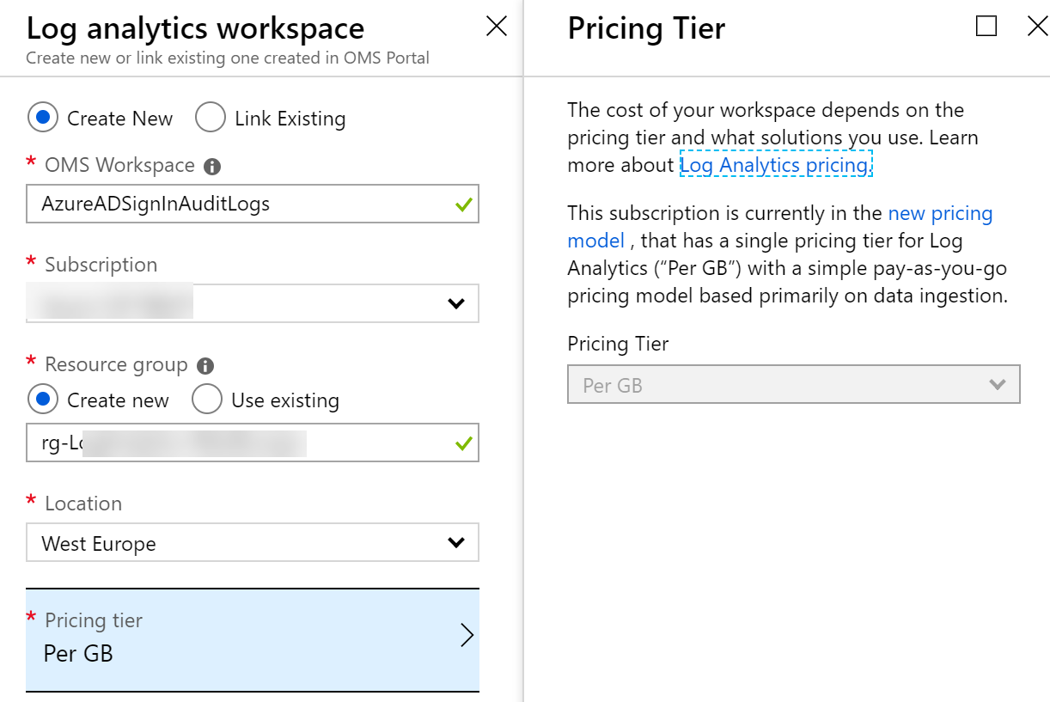
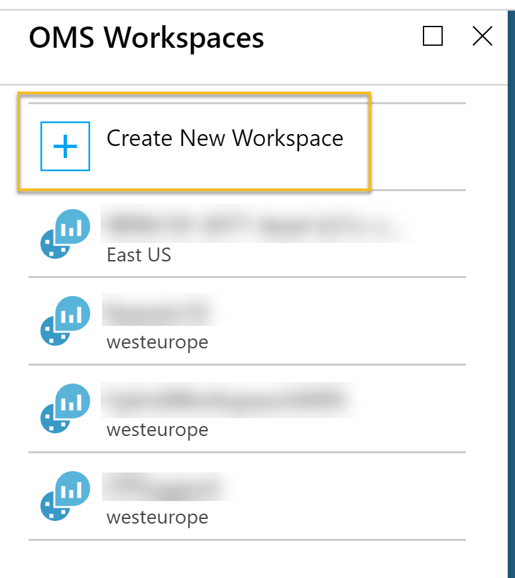
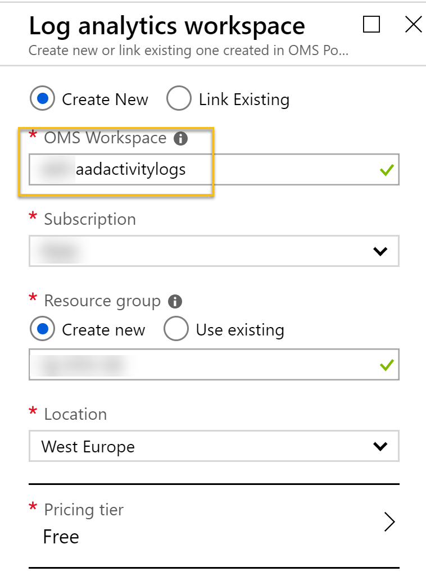
Konfigure Log Analytics Workspace
Notes:
Important info! Usually you will need to be a Global Administrator or Security Administrator to be able to access the details of Sign-in logs or Audit logs in Azure AD, but by exporting this data to either an existing or a new Log Analytics workspace, potentially a lot more users can access that data. You need to think about if this is something you want to do, and at least control and govern which users can access that Log Analytics workspace.
For this reason alone it would probably be a better idea to create a dedicated Log Analytics workspace for the Azure AD activity logs:

Slide 9
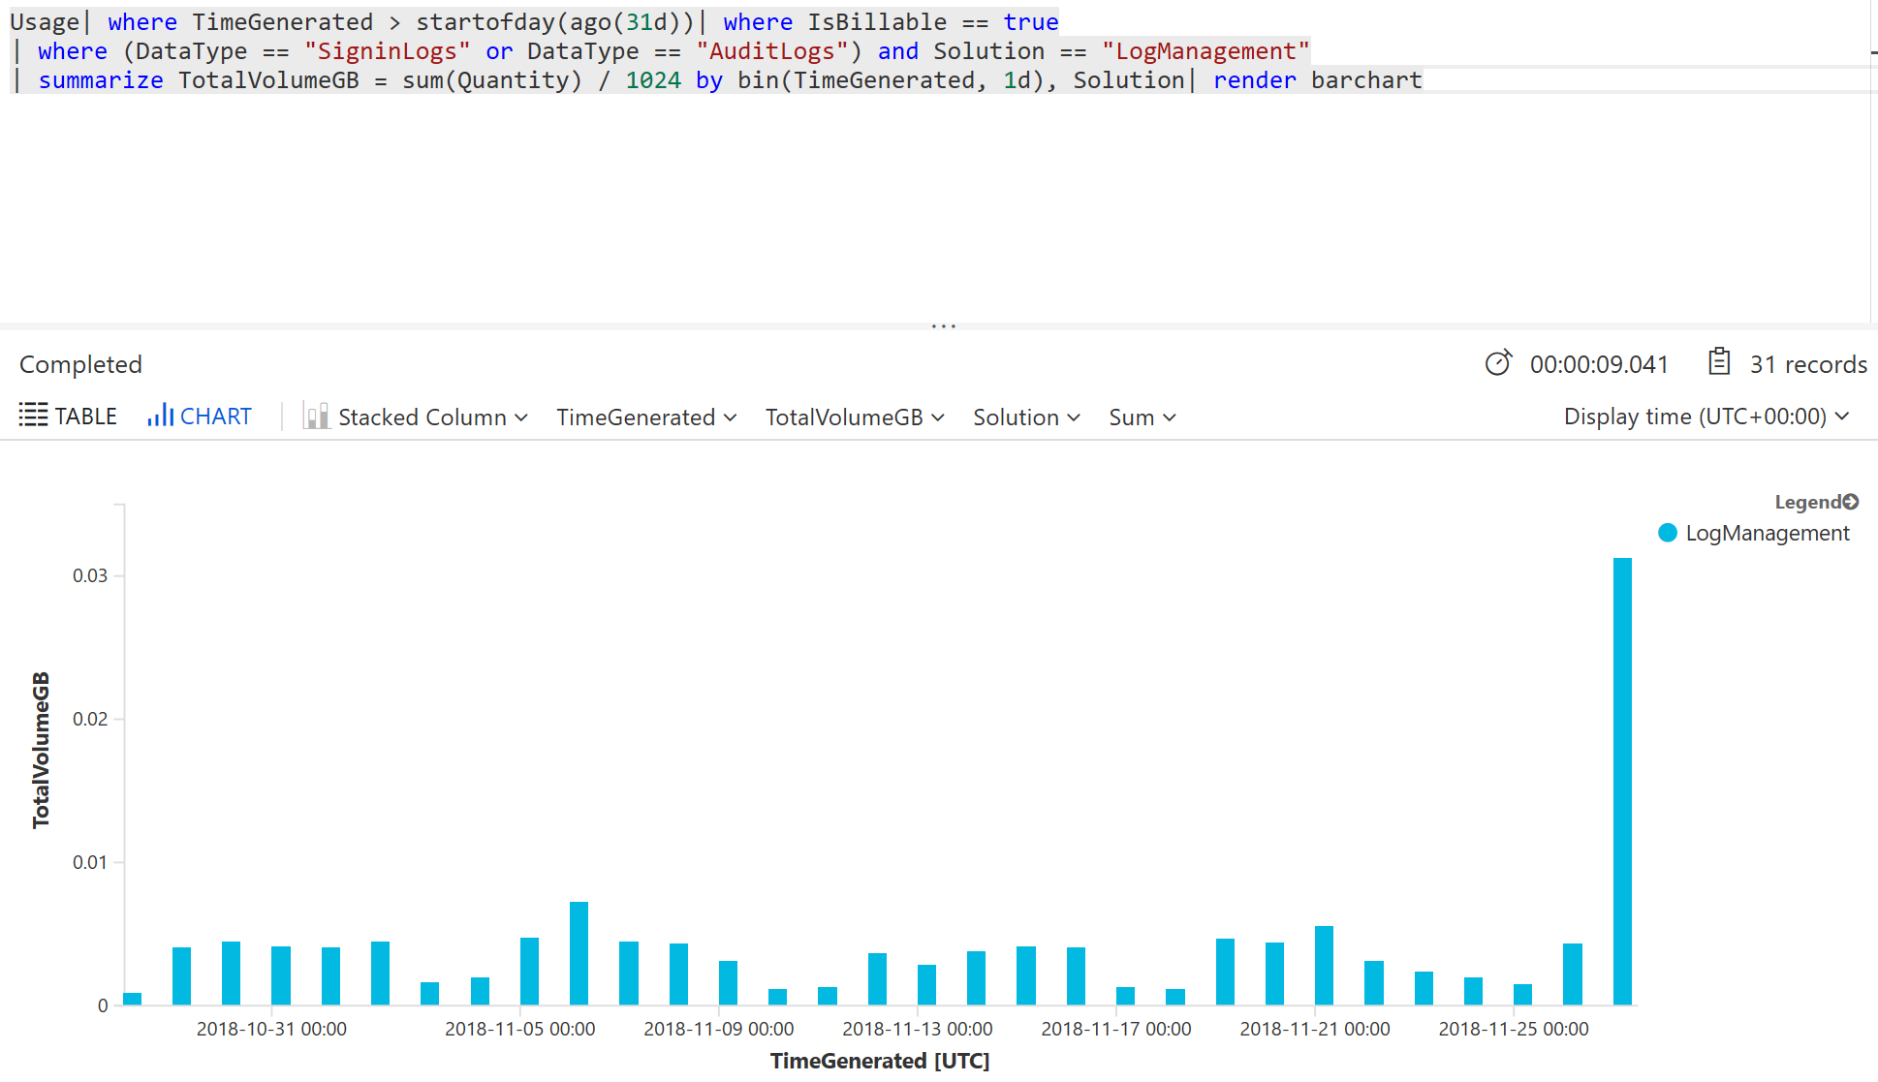
Kost ved å lagre Azure AD Activity Logs?
Notes:
Choosing a pricing tier depends on whether the Subscription was created before April 2, 2018 or not, or whether you have elected to move to a new pricing model. The older pricing model had a choice of free tier, which had a daily cap of 500 MB and a data retention of 7 days. As the diagram above showed, most organizations will be way below the 500 MB daily cap, but a retention of only 7 days will be considered short for most analyzing needs. So under the older pricing model you would consider a standalone per GB model, giving a retention of 1 month by default, but a cost of $2.30 per GB.
The new pricing model after April 2, 2018 has a simplified pricing model. Here the first 5 GB are free and you have a default retention of 31 days. Additional GBs for ingestion are $2.99 per month, and extra retention after the first 31 days is $0.13 per GB per month. Note that this pricing model is on subscription level and affects all your Log Analytics workspaces, so you need to carefully consider any changes to the new pricing model in your subscription.

Slide 10
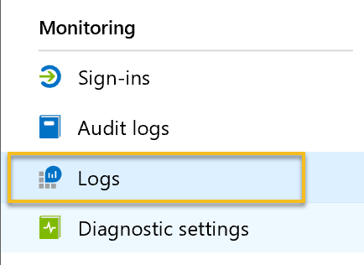
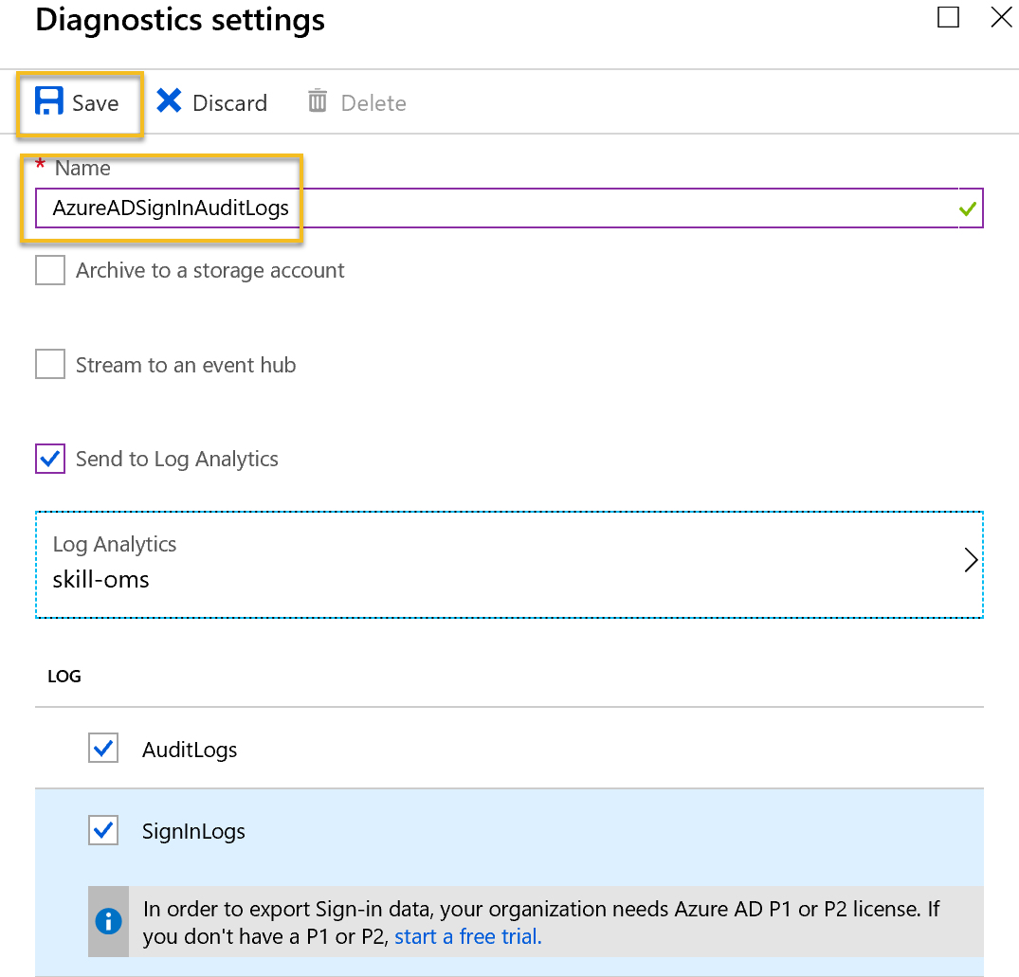
Fullføre Log Analytics Integrasjon

Slide 11
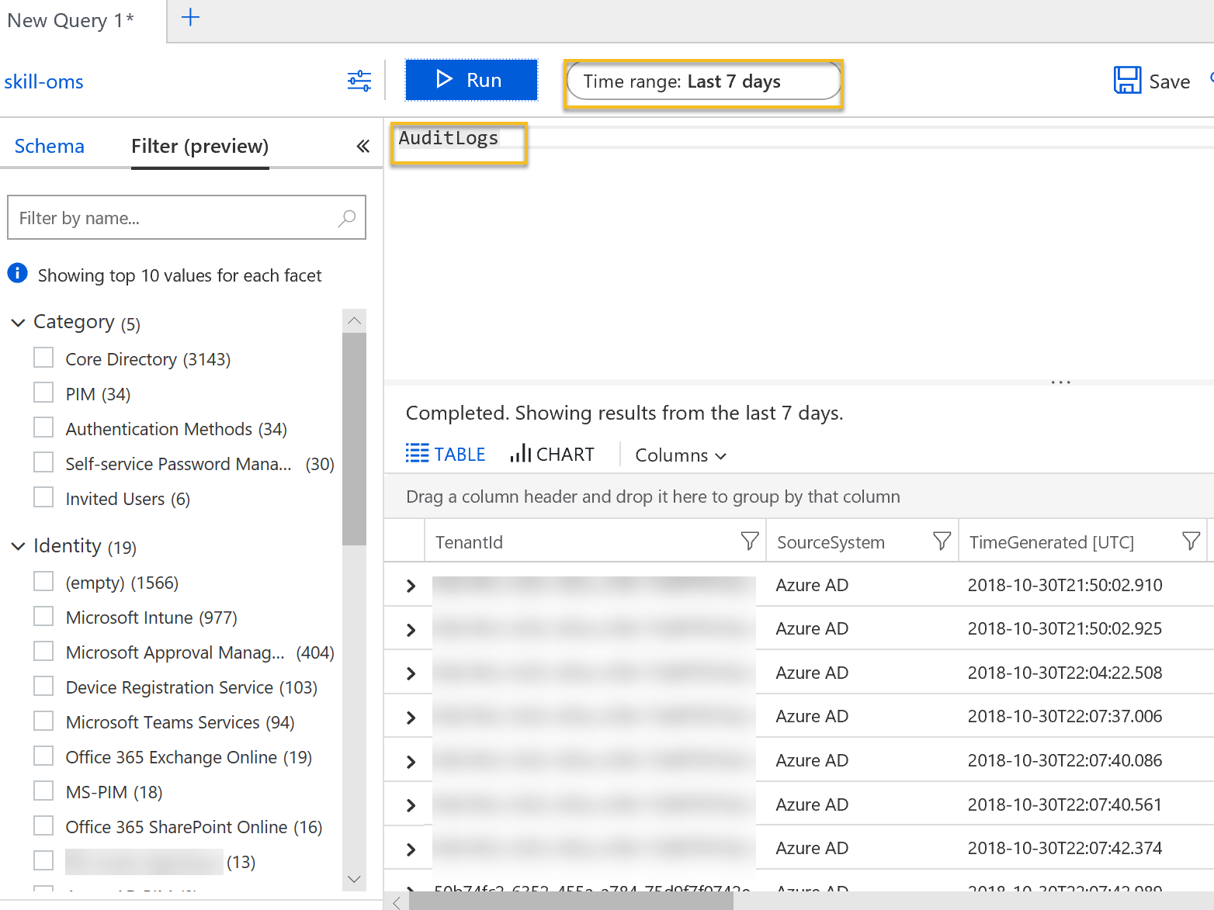
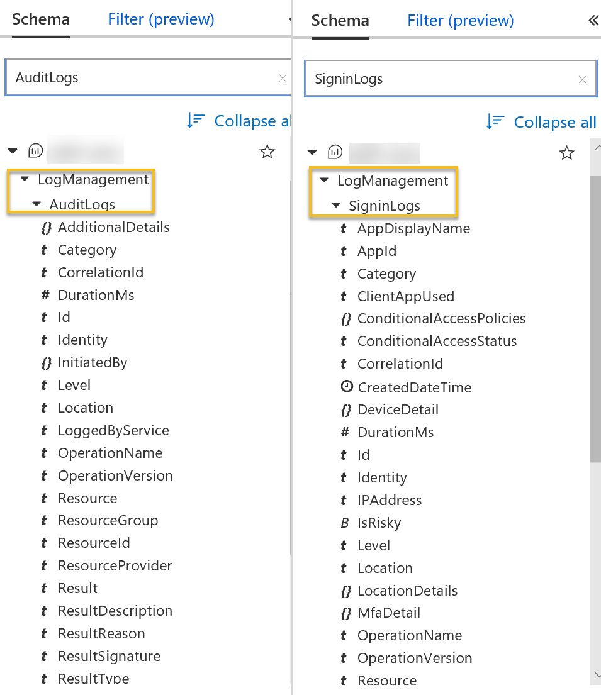
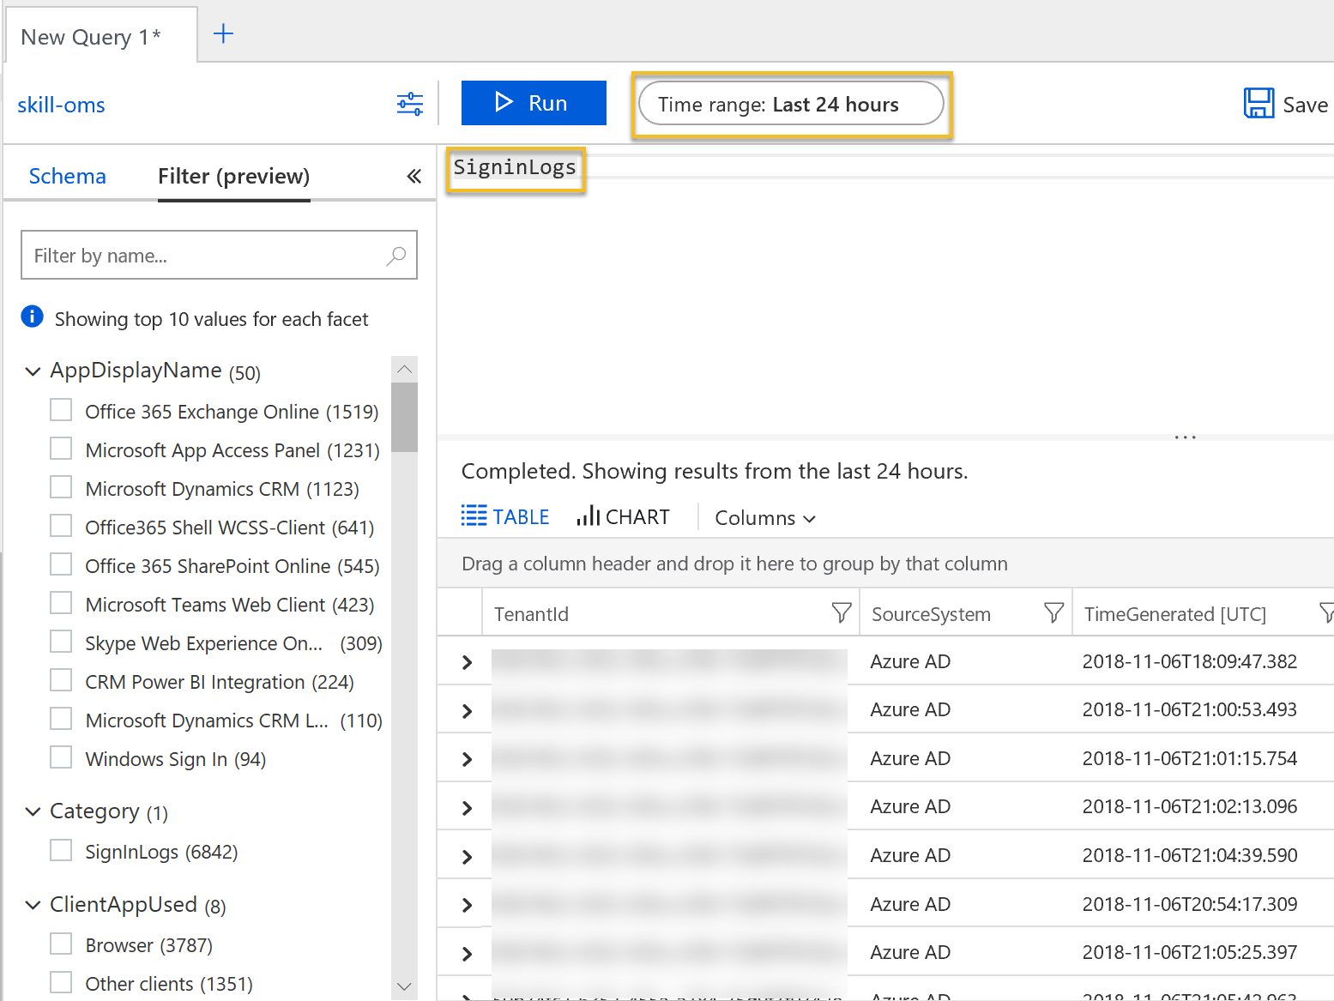
Azure AD Activity Logs Schema og Filter

Slide 12
Ressurser for å komme i gang
Integrate Azure AD logs with Log Analytics using Azure Monitor: http://aka.ms/AzureADLogAnalytics
Analyze Azure AD activity logs with Log Analytics, sample queries: https://aka.ms/AzureADLogAnalyticsqueries
Install and use the Log Analytics views for Azure Active Directory: https://aka.ms/AADLogAnalyticsviews
Lær Kusto: https://docs.microsoft.com/en-us/azure/log-analytics/query-language/get-started-queries
https://portal.loganalytics.io/demo
Pluralsight: “Kusto Query Language (KQL) from Scratch”

Slide 13
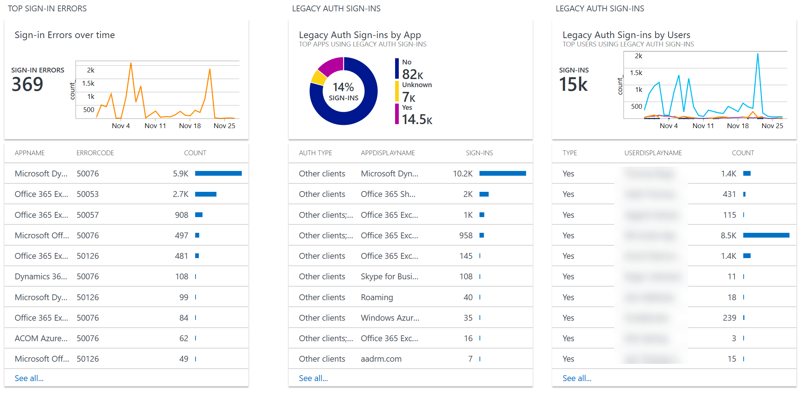
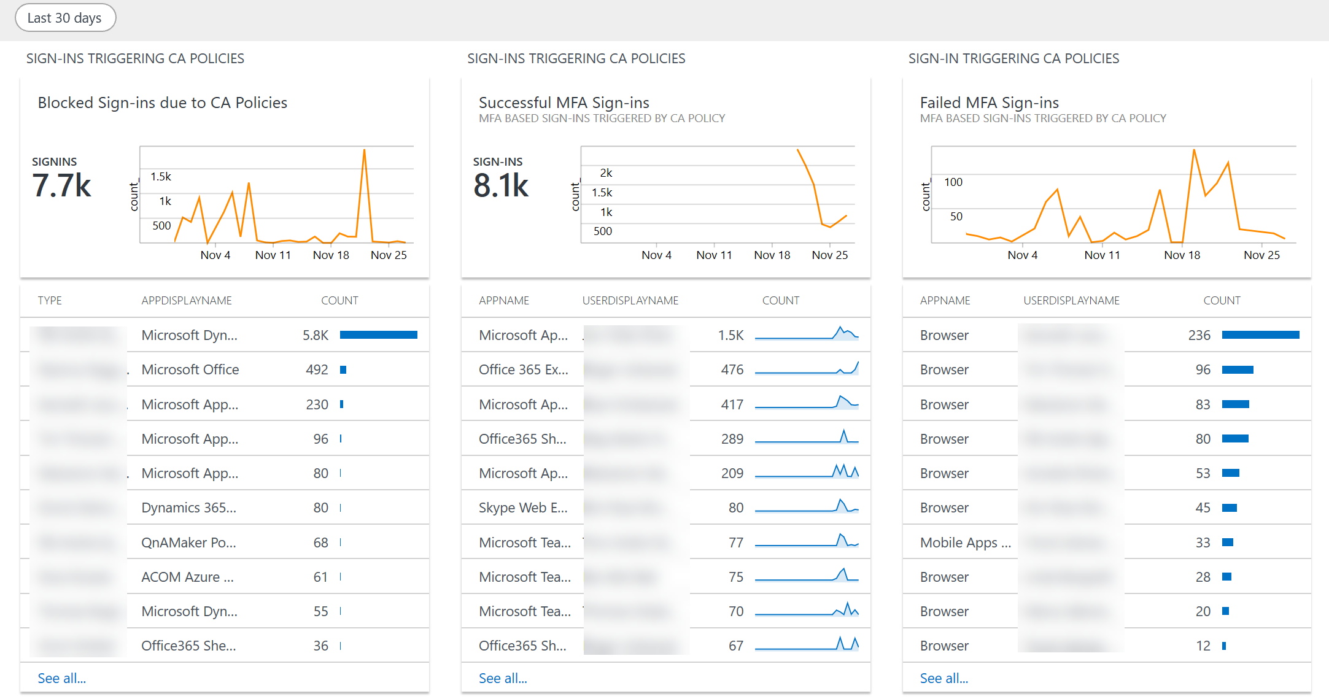
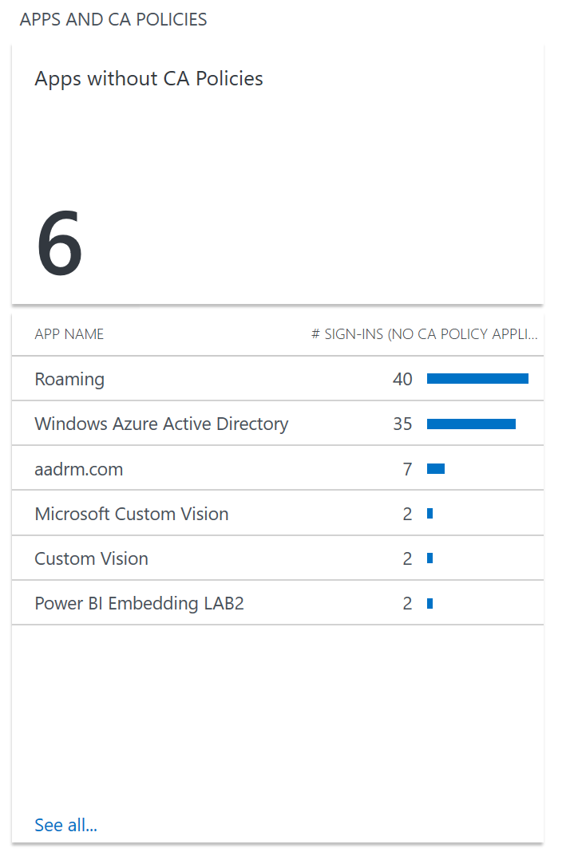
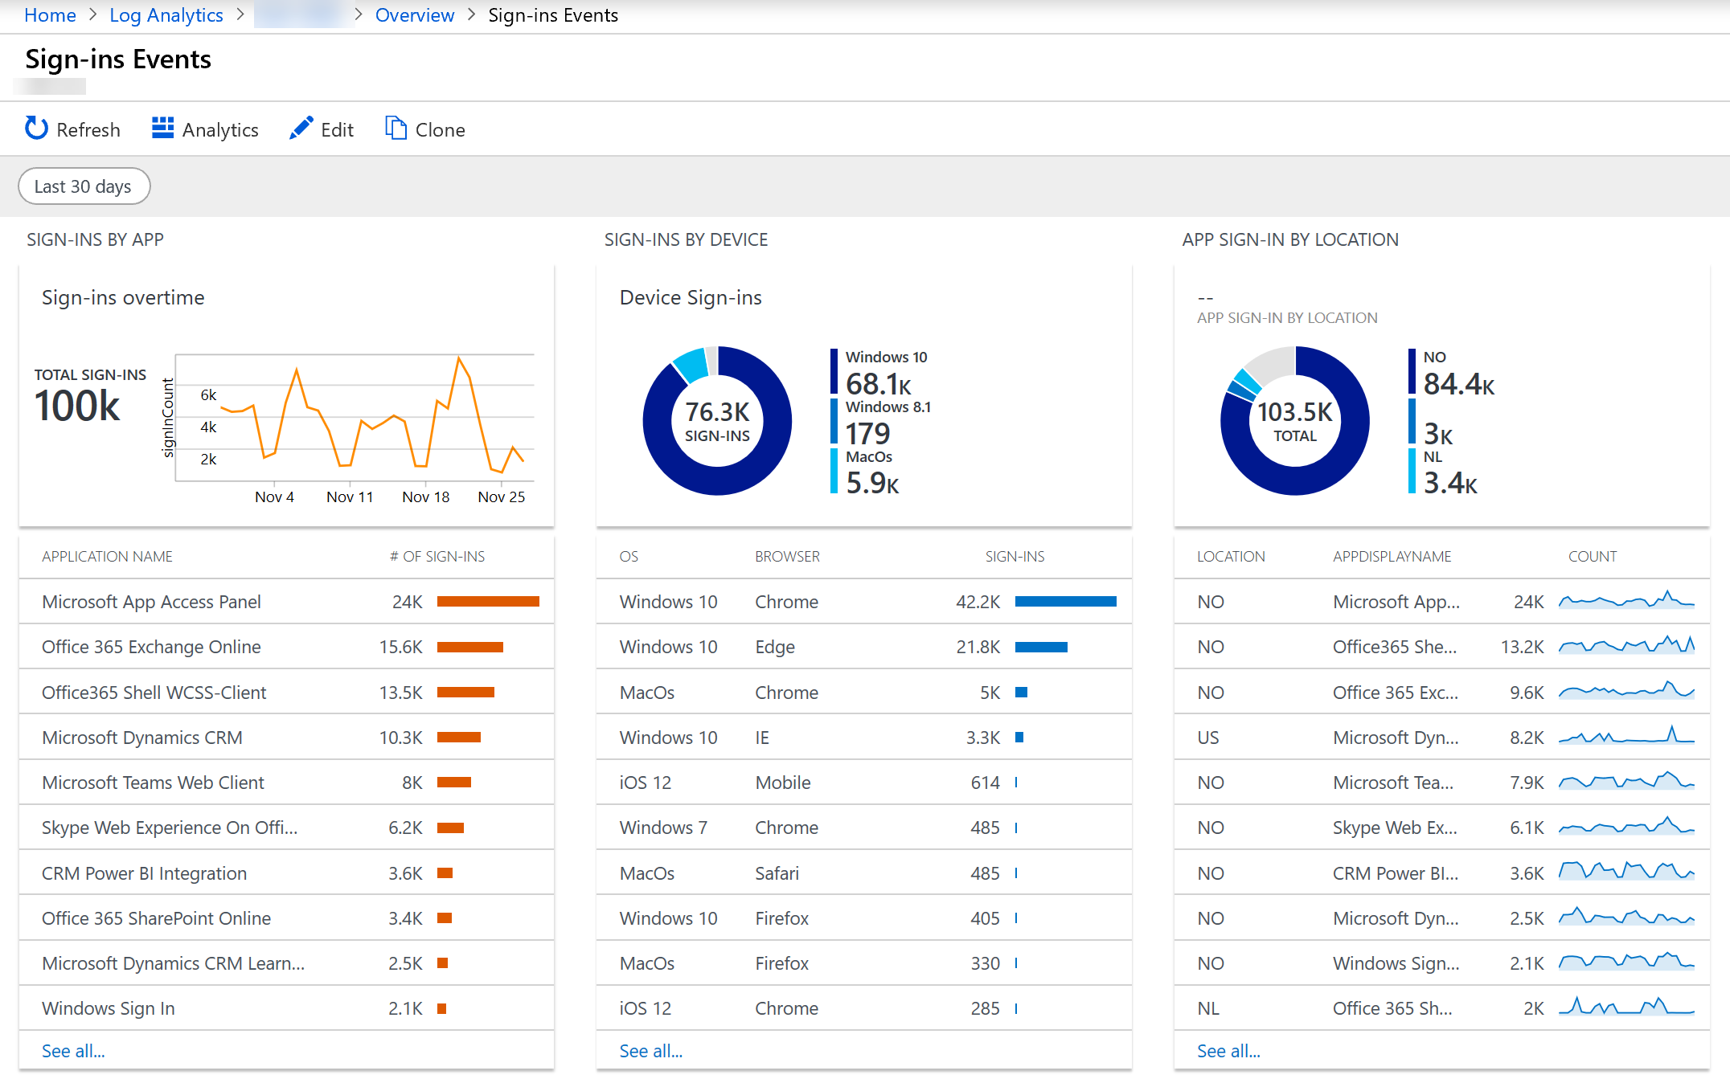
Log Analytics Views fra Microsoft (Github)

Slide 14
Demo
Log Analytics og Azure AD Signin og Audit Logs

Slide 15
Blogg artikler
https://gotoguy.blog/2018/11/06/get-started-with-integration-of-azure-ad-activity-logs-to-azure-log-analytics/
https://gotoguy.blog/2018/11/11/alert-on-on-premises-connectivity-for-self-service-password-reset-using-azure-monitor-and-azure-ad-activity-logs-in-log-analytics/
https://gotoguy.blog/2018/11/21/exploring-azure-mfa-sign-in-failures-using-log-analytics/
Azure AD Log Analytics Views (Kommer!): https://github.com/skillriver

